Slide 1
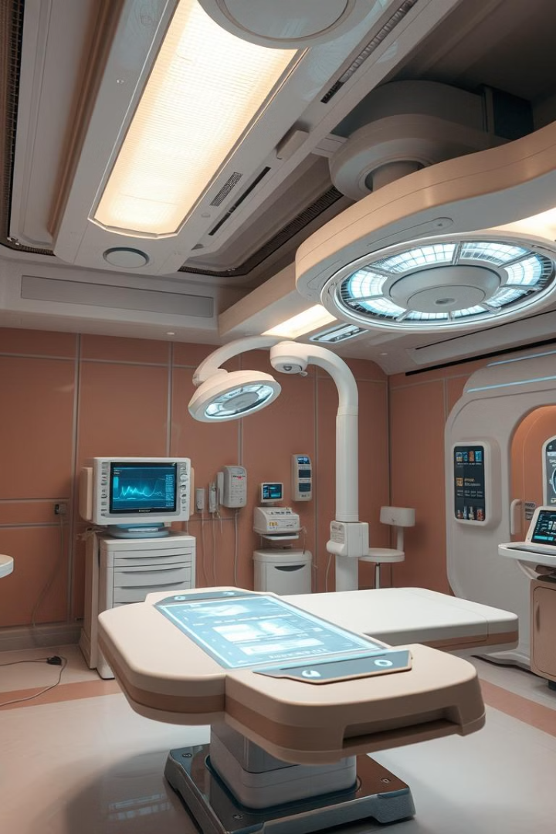
AI in Healthcare Hub and
chat bot :
Artificial intelligence is rapidly changing the healthcare landscape. This presentation explores how AI is revolutionizing medicine, from improving patient care to enhancing research and development.

Slide 2
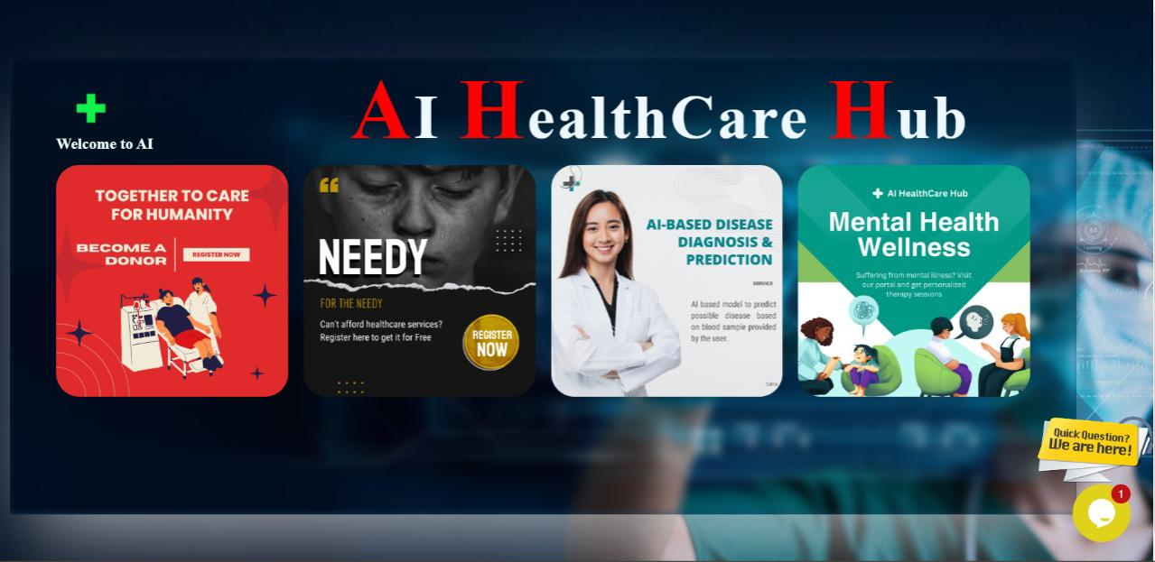

Slide 3

Donor Portal: Revolutionizing Organ Donation
Streamlined Process
Increased Efficiency
AI-powered donor portals simplify the donation process, connecting potential donors with patients in need.
AI algorithms analyze donor data, matching recipients with compatible organs more efficiently.

Slide 4
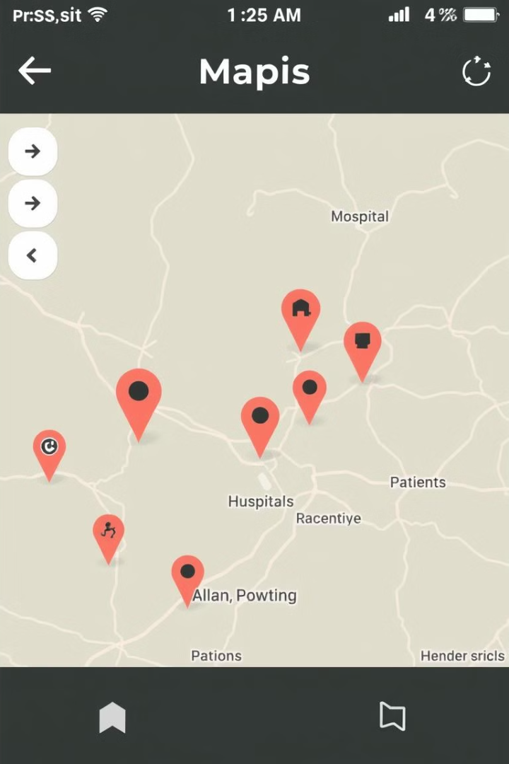



Needy Platform: Connecting Patients with Care
Hospital Locator
Doctor Search
Patients can easily find nearby hospitals and clinics.
Search for doctors by specialty and location.
Patient Support
Connect with other patients for peer support and advice.

Slide 5
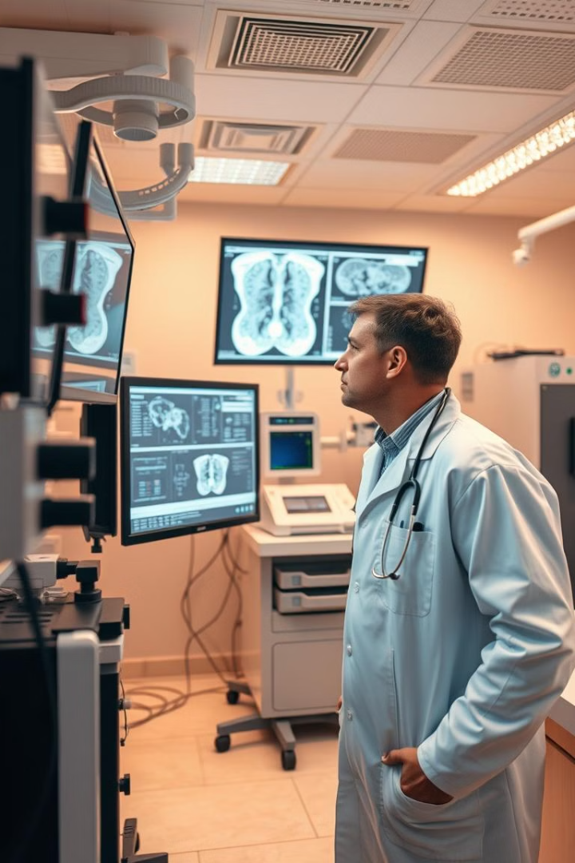
AI-Based Disease Diagnosis and Prediction
1
Early Detection
2
Personalized Treatment
AI can analyze medical images and detect diseases earlier, leading to better outcomes.
AI algorithms can tailor treatments based on individual patient data.
3
Predictive Modeling
AI can predict the likelihood of future health issues.

Slide 6



Mental Health Wellness: Chatbots and Beyond
Chatbots
1
Provide accessible and confidential mental health support.
Therapy
2
AI-powered platforms facilitate online therapy and coaching.
Wellness Programs
3
AI can create personalized wellness plans and track progress.

Slide 7


